Slide 2
prometheus 使用 ipmi exporter
cat ipmi_remote.yml
modules:
xx.x.x.x: #遠端server IP
user: “root” #名稱
pass: “xxxxxxxxxxxxx” #密碼
# Available collectors are bmc, ipmi, chassis
collectors:
- bmc
- ipmi
- dcmi
- chassis
#增加監控ipmi exporter rules 規則 - "rules/Memory_hardware.yml"
- "rules/power.yml"
- "rules/fan.yml"
- "rules/processor.yml"
- "rules/harddisk.yml"

Slide 3
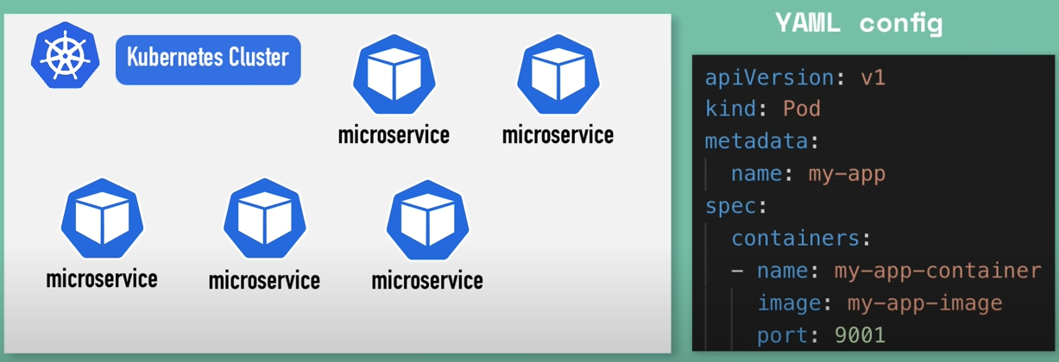
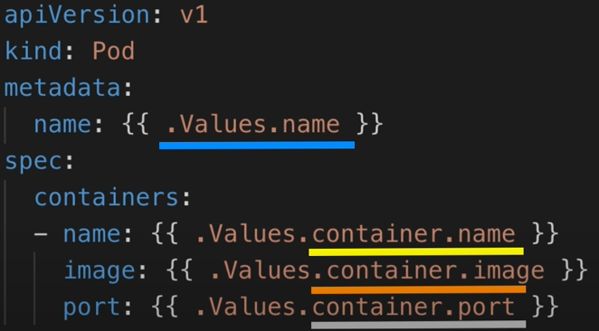
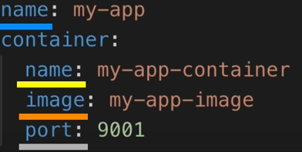
Deploy server configuration are almost the same
{{.Values}}

Slide 4
pipeline_stages:
可以解析
docker: {} //https://grafana.com/docs/loki/latest/clients/promtail/stages/docker/
{"log":"log message\n","stream":"stderr","time":"2019-04-30T02:12:41.8443515Z"}
output stream timestamp
cri: {} //Container Runtime Interface 這個就是k8s讀取container的格式
"2019-01-01T01:00:00.000000001Z stderr P test\ngood"
time stream log
json
與docker類似
https://grafana.com/docs/loki/latest/clients/promtail/pipelines/
目前理解，就是說透過loki-stack讀取k8s node 或是 pod的值，下面這個是k8s提供的api，然後再透過relabel_config重新命名
https://grafana.com/docs/loki/latest/clients/promtail/configuration/#kubernetes_sd_config
之後再用pipeline statge 進行label的製作，並篩選出來自己想要的label
https://cloud.tencent.com/developer/article/1824986
****確認如何在loki-stack promtail如何監控指定的log file****

